Slide 1
2019 Pathway to Tokyo
Presented by Sebastain Garikai

Slide 2
OUR TALENTEES SET OBJECTIVES
To perform a personal best in the year (objective achieved 75%)
To qualify for regional/continental games, etc.
(objective achieved)
To qualify for the Olympic Games- TOKYO-2020, etc.(IN PURSUIT)

Slide 3
DNNS NAAZ -FOCUS GROUP AND CONSULTATIVE FORUM
6 key pillars
Governance
Organizational effectiveness
Athlete development and support
Capacity development
Resource mobilization
Sustainability

Slide 4
PILLAR 3
DNNS NAAZ -FOCUS GROUP
ATHLETE DEVELOPMENT AND SUPPORT
Talent identification
Long Term Athletes Development Strategy
Coach development
High performance training
Access to sports science, medicine and technology
Access to appropriate facilities and equipment
Exposure to balanced competition

Slide 5
ATHLETE DEVELOPMENT AND SUPPORT
8. Anti-doping and safe sport education
9. Stakeholder support
10. Athlete profiling
11. Research
12 monitoring and evaluation e.g scholarship athletes
UNVEILING OF SHORTLISTED ATHLETES FOR TOKYO 2020

Slide 6
COACHES SUPPORT PROGRAMS
IAAF LEVEL 2 SPRINTS AND HURDLES HIGH PERFOMANCE COACHING 03-10 DECEMBER 2019
11 PARTICIPANTS FROM THE REGION
(3 BOTWANA, 1 MALAWI, 7 ZIMBABWEANS)
4 Passed

Slide 7
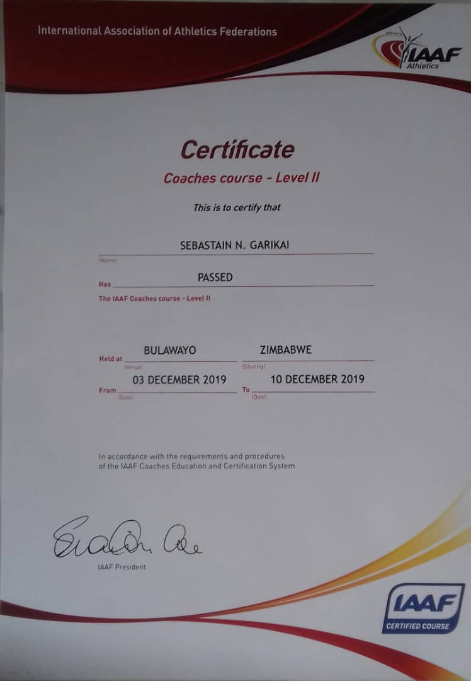

Slide 8
NSA/BUSE SHORTLISTED ATHLETES
NORMAN MUKWADA 400M/H :PB 49.54-
TARGET 48.90S
-4x400M
DICKSON KAPANDURA 200M PB 21.03
TARGET 20.24
-4x100
OUR PLAN IS TO FOCUS ON INDIVIDUAL EVENT QUALIFICATION FIRST

Slide 9
ATHLETE SUPPORT PROGRAMS
identified and planned,
work collaboratively with the NAAZ Athletics Performance Support team and you local Support team.

Slide 10
Individual Athlete Plan (IAP)
Necessary conditions to make progress
Competition and key training plan details
Local /Regional and International training camps
Qualification competition opportunities
Financial support
key Support Service requirements

Slide 11
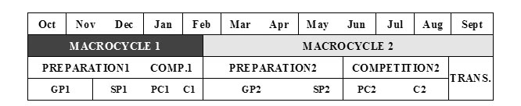
Individual Annual Athlete Plan (IAP)

Slide 12
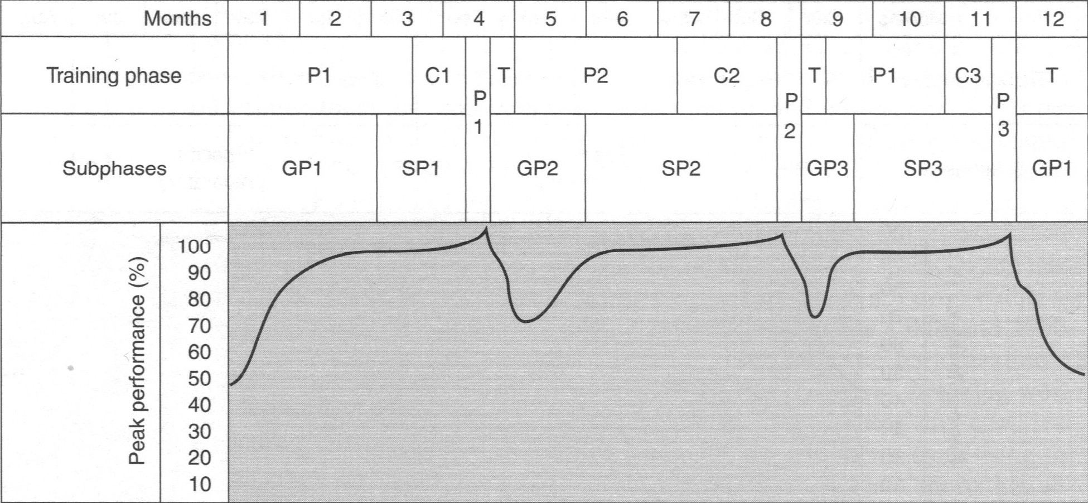
OVERVIEW OF OUR PLAN

Slide 13
Aug - Sep
●
Olympic Games
SPRINTS PATHWAY
By Sebastain Garikai
Jun - Jul
●
Q. Africa Senior Champs Algeria
May
●
Q. Botswana National Competition
Apr
●
SPP 2 training 3 days tartan UZ Track
Feb-March.
●
Qualification competitions SA series
Jan-Feb
●
SPP 1 training 3 days tartan UZ Track
Dec. – Jan.
●
GPP. Training camp (High Performance Centre) 8Dec 2019 – 8 Jan 2020
Oct-Nov.
●
Exams +GPP
Qualification Window closes on 29 July

Slide 14
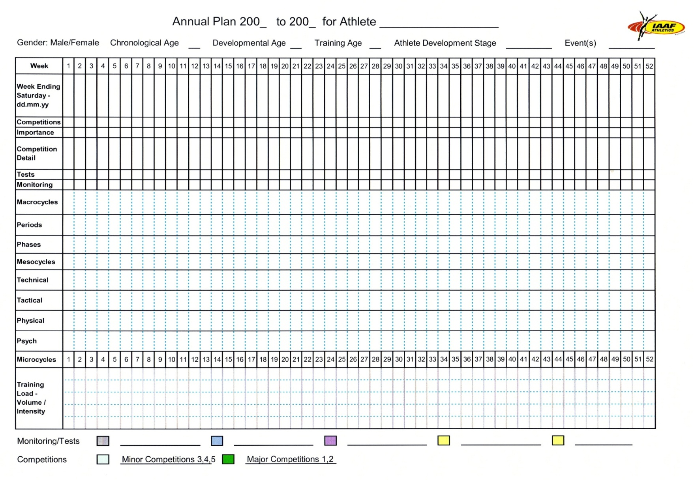
Monitoring and evaluation tool

Slide 16
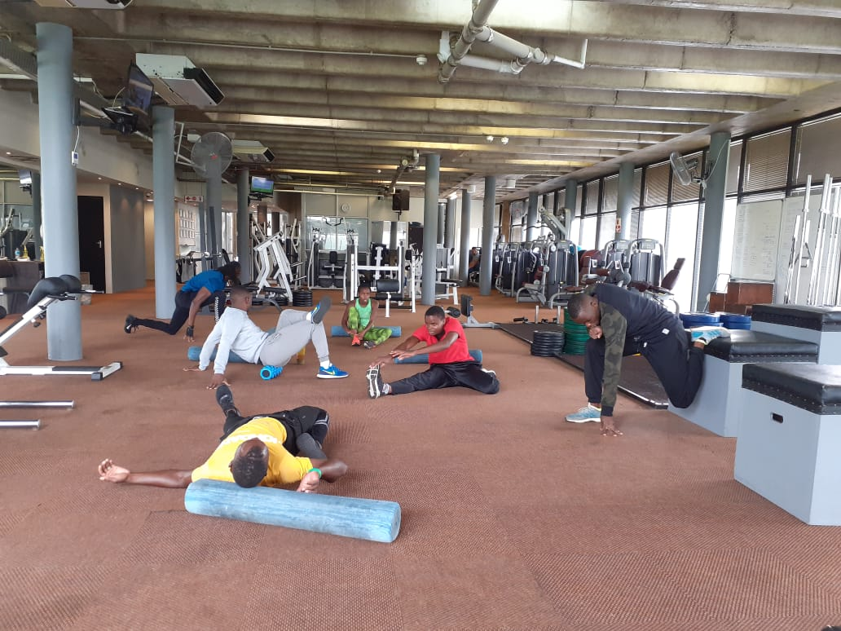
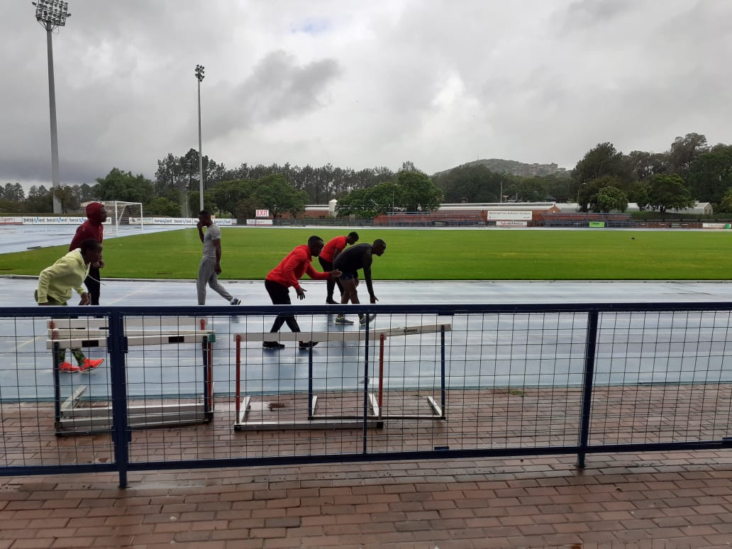
GPP1- HPC(SA) Current settings

Slide 17
Support Services needed to achieve set targets
Psychological
goal setting
Social
stress management
focus/concentration
imagery / visualization

Slide 18
Support Services needed to achieve set targets
MEDICAL
Injury Prevention
Recovery treatments
nutrition
hydration

Slide 19
Sport Science and Medical Support
Athlete tracking
Athlete profiling
Physical testing and interventions
Medical testing (including physiotherapy, etc.)
Psychological services
Sports nutrition
Biomechanics
Strength and Conditioning

Slide 20
Life Skills
Media training
Interpersonal skills
Career guidance
Coping with traveling
Etiquette and protocol
Legal/contracts
Financial management
Conflict management
HIV/AIDS
Stress management
Educational liaison.

Slide 21
Sports Technology
event analysis
Video-based biomechanical analysis
Video-based technique analysis
Simulation and modeling
Information and knowledge management
Communication technology
Biofeedback technology
Technology tracking CNS reaction to various external stimuli

Slide 22
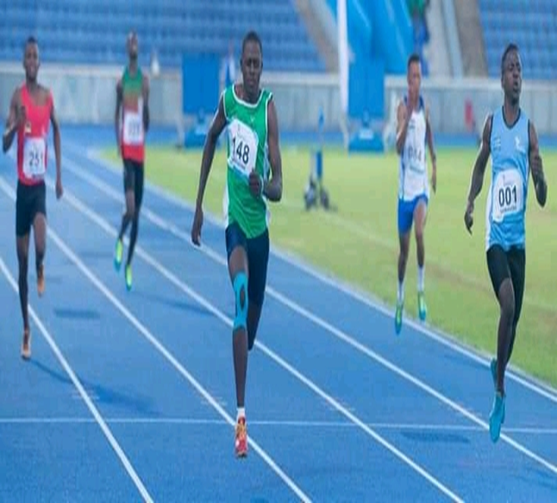
DICKSON KAPANDURA

Slide 23
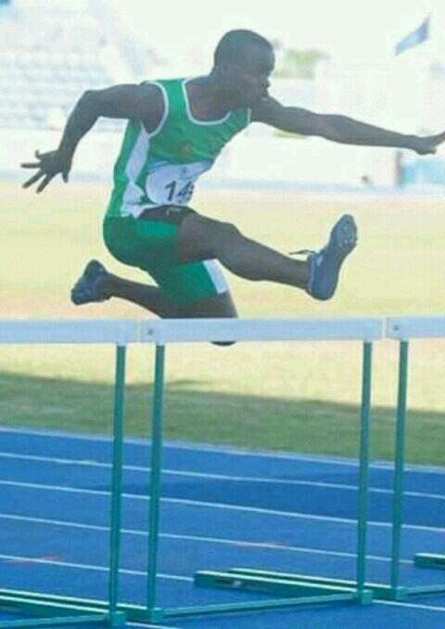
NORMAN MUKWADA

Slide 24
THANK YOU

