Slide 1

COACHING AND COMPETITIONS
UP TO 2019 SUMMARY
BUSE NATIONAL SPORTS ACADEMY

Slide 2
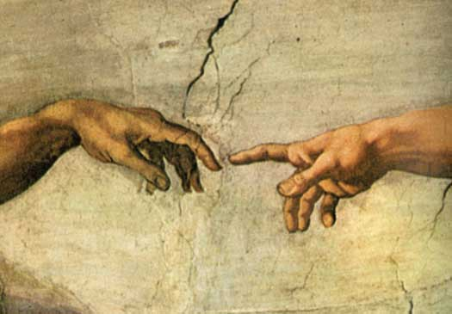
OUR REALITY ?
‘The greatest danger for most of us is not that our aim is too high and we miss it, but that it is too low and we reach it.’
WE AIM TO GET ON THE INTERNATIONAL PODIUM

Slide 3
NATIONAL SPORTS ACADEMY
Track and Field Overview (2019)
“It takes a village to raise a child, it takes a system to develop an athlete”
Our programme is developing from strength to strength.
Results for our athletes compared to the region and world at large are evidence of this
but more work and better systems need to be put in place.

Slide 4
NATIONAL SPORTS ACADEMY
TALENTEES OBJECTIVES
To perform a personal best in the year [75% achieved 2018 season-so far 5pbs in 2019 ]
To break the national record, qualify for regional games, etc.(achieved extensively 2018 season)
3. To participate and win medals at AUSC Region 5 games.(achieved)
4. To qualify for the , (All Africa) African Games, IAAF World Championships, Olympic Games, etc.
(partially achieved and on going)

Slide 5
NATIONAL SPORTS ACADEMY
COACHING SYSTEM
includes localised coaches and peripatetic coaches.
Outside of residence talentees are provided with training programmes- Monitored centrally at the Academy.
NAAZ Coaches directors for youth, juniors and seniors assist.
Camps are organised for our talentees before major events.
Competitions regionally are organised for our athletes to prepare them for the world stage.

Slide 6
NATIONAL SPORTS ACADEMY
COACHING SYSTEM
Community - coaching, provision of training programmes, monitoring of athletes and assisting local coaches progress all year long.
Provincial- coaching, provision of training programmes, monitoring of athletes and assisting local coaches progress through qualifiers and competitions.
National- coaching, provision of training programmes, monitoring of athletes and assisting local coaches progress through qualifiers and major international competitions.

Slide 7
NATIONAL SPORTS ACADEMY
COACHING SYSTEM
Athlete centred approach
Coach driven programmes
Management supported system
Bring together best athletes and best services to provide best daily training environment.

Slide 8

NATIONAL SPORTS ACADEMY
“Bring together best athletes, best coaches, best services ‘
Nutritionist
Assistant Coach
S + C Expert
Head Coach
Coach
Performance Analyst
Physiotherapist
Athlete
Massage Therapist
Doctor
Psychologist
Exercise Physiologist
Biomechanist

Slide 9
DAILY TRAINING ENVIRONMENT(DTE)
The environment that the athletes experience every day determines performance success.
Our daily training environment has allowed us to register a good level of success.
We are grateful for the efforts that have been put in place to make sure our DTE is supportive to the achievements of set objectives for talentees.

Slide 10
DAILY TRAINING ENVIRONMENT(DTE)
Our Successful performances depend on a balanced integration of these factors;
Coaching
Sports science and sports medicine
Recovery and performance Analysis
Training and competition equipment
Training venues/ facilities/ transport
Financial resources
management

Slide 11
NATIONAL SPORTS ACADEMY competitions overview so far
Careful selection of competitions.
Overall good performances
Difficult congested period due to Nash competitions
Recovery and rehabilitation
Most venues besides Harare and Bulawayo are not standard

Slide 12
Summary of Major Achievements-
CAA SELECTION competition (Harare/Bulawayo 2019)
Athletes that were selected
800m -Priviledge Chikara u18-
High jump-Brian Ndlovu u18
200M-Dorothy Kavhundura u20
Triple jump-Dorothy Kavhundura u20
100m-Dickson Kapandura open
1500m Nyasha Mutsetse open

Slide 13
Summary of Major Achievements-
JM BUSHA competition (BULAWAYO)
National Sports Academy talentees =14
9 Gold,
3 Silver and
2 Bronze.
3 personal best posting
800m -Priviledge Chikara
Long jump-Dorothy Kavhundura
100m-Dickson Kapandura
4minute mile qualifier- Nyasha Mutsetse

Slide 14
Summary of Major Achievements-
UZ INVITATIONAL (HARARE)
National Sports Academy talentees =21 medals
(15 Gold,
4 Silver and
2 Bronze).
2 personal best posting,( 400m, D Kapandura 47.13s)
1 new National record (high jump B Ndlovu 2.11m)

Slide 15
Summary of Major Achievements-
ZUSA NUST (BYO)
National Sports Academy talentee =2 medals
1 Gold, 400m
1 Silver 200m
1 personal best posting,( 400m, Leon Tafirenyika 47.32s)

Slide 16
Summary of Major Achievements- Inter district competition (NZVIMBO)
Bindura District = 44 medals,
National Sports Academy talentees =33medals
22 Gold,
6 Silver and
5 Bronze.
13 talentees are representing the province Mashonaland Central at the NASH competition.

Slide 17
Summary of Major Achievements REGION FIVE GAMES PERFORMANCES
Team Zimbabwe = 16 medals,
National Sports Academy talentees =10
      (4 Gold,
      4 Silver and
      2 Bronze).
The Academy was represented by nine (9) athletes

Slide 18
March- April 2019
Upcoming competitions
NASH –MIDLANDS
HARARE INVITATIONAL
BUSE?
BOTSWANA INVITATIONAL
CAA U20/U18 Championships
JMBUSHA Mutare Edition

Slide 19
TALENTEES TIERS
(Bronze, Silver, Gold and the Target Talent Program (TTP)
GOLD
SILVER
BRONZE
TTP

Slide 20
NATIONAL SPORTS ACADEMY
SILVER TIER- TALENTEES
Dickson Kapandura
Brian Ndlovu
Mukhokeli Sibanda
Norman Mkwanda
Dorothy Kavhumbura
James Mutenje
Leon Tafirenyika
Maryjoy Mudyiravanji
Wayne Nkomo
Kevin Chiku
Priviledge Chikara
Nyasha Mutsetse
The Vice Chancellor hosted an Awards Ceremony and presented the silver tier blazers to the talentees on Friday, 1 February 2019

Slide 21
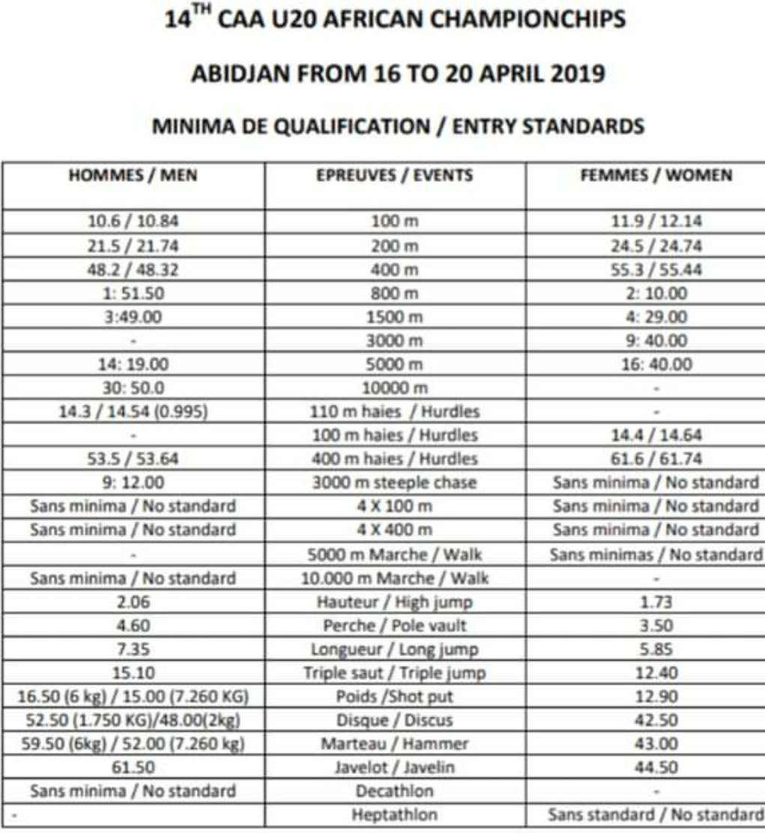

Slide 22
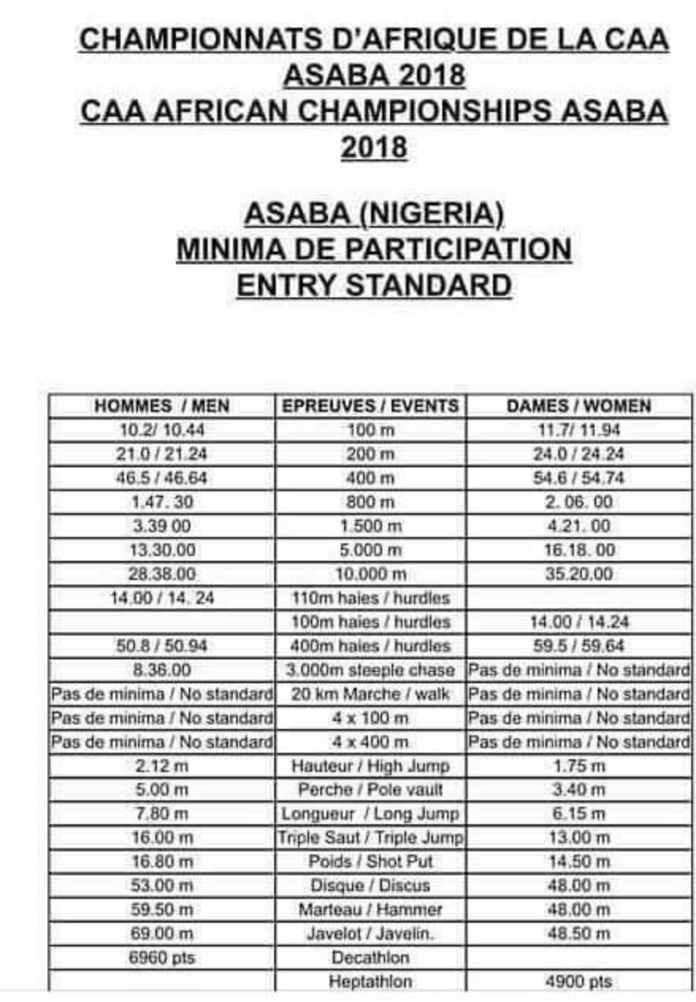

Slide 23
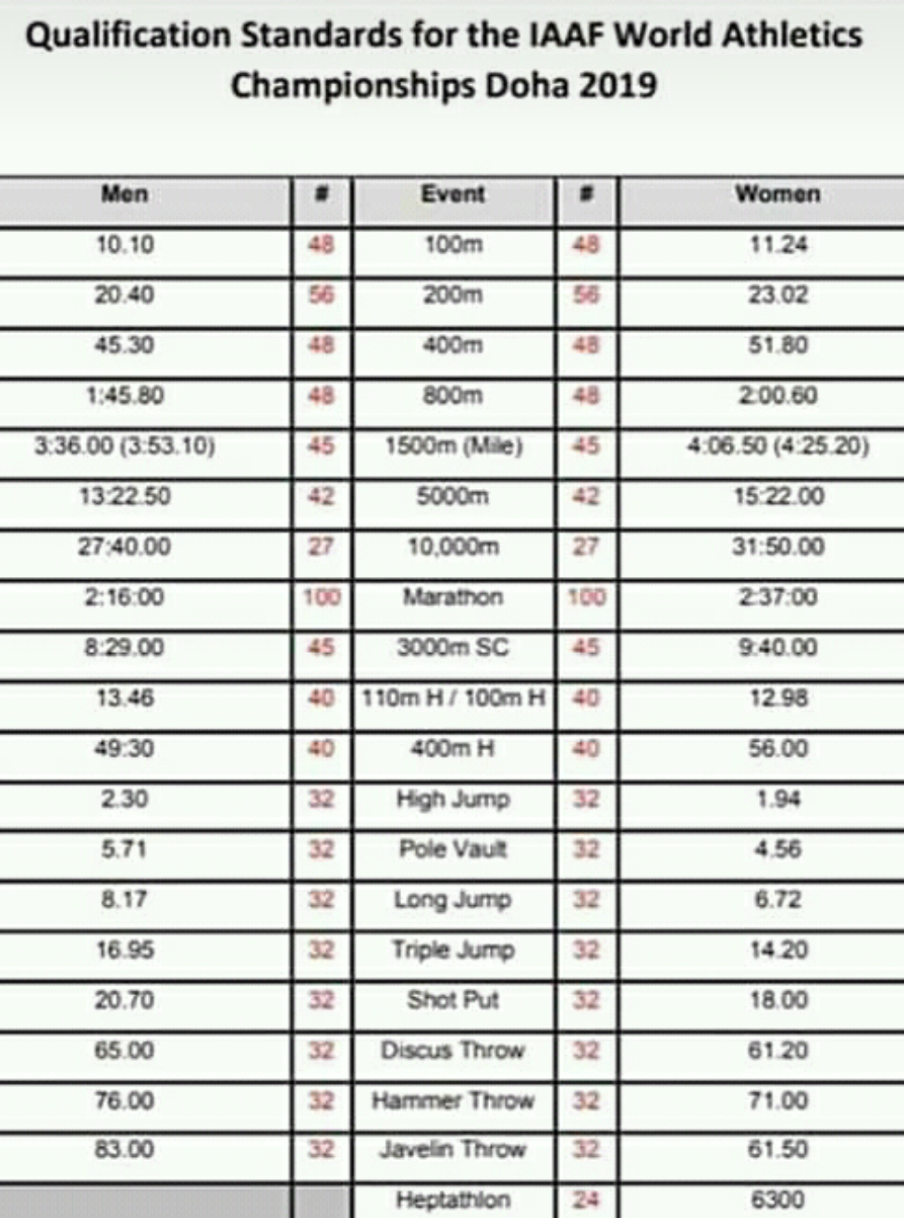

Slide 24
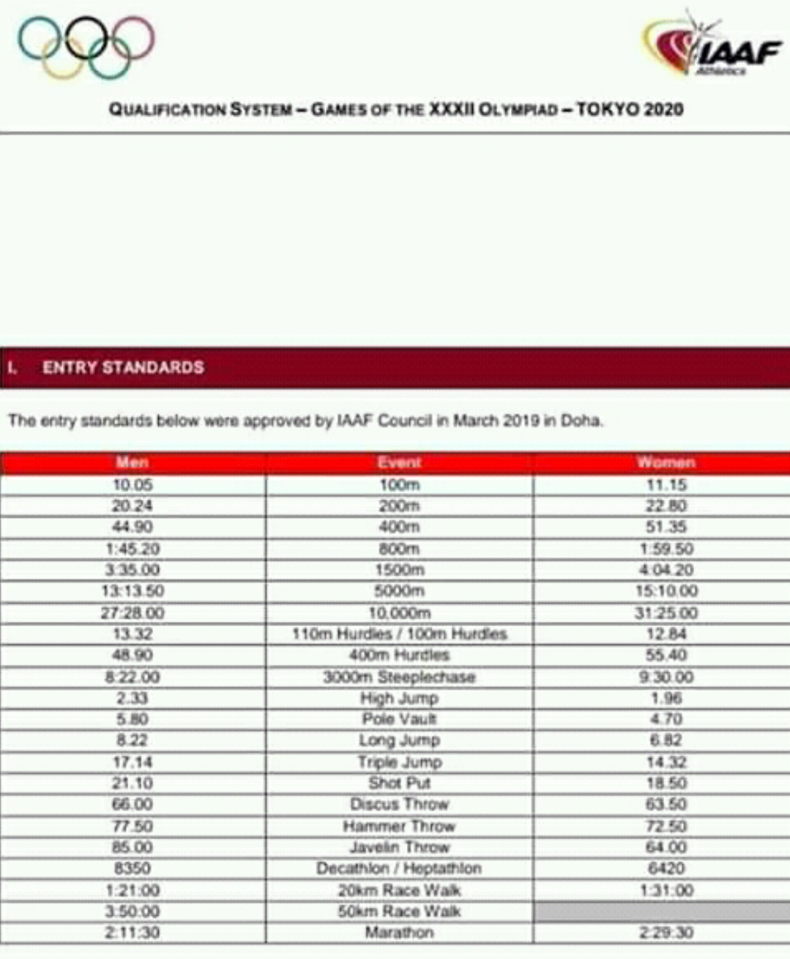

Slide 25
NATIONAL SPORTS ACADEMY-
TALENTEES ACHIEVEMENTS IN SUMMARY
NAME | EVENT | PERFORMANCE
Linnet Zembe | 100 m 200 m Long jump | 12.89 s 27.01s 5.26 m

Slide 26
NATIONAL SPORTS ACADEMY-
TALENTEES ACHIEVEMENTS
David Nyamufarira | 80m/h 300m/h | 13.06s 48.36.6s

Slide 27
NATIONAL SPORTS ACADEMY-
TALENTEES ACHIEVEMENTS
Sharon Mhembere | 400 m 200m | 58.98s 25.78s

Slide 28
NATIONAL SPORTS ACADEMY-
TALENTEES ACHIEVEMENTS
Maryjoy Mudyiravanji | 800m | (2.11.08s) Nigeria Senior African Championships – 2018
Nyasha Mutsetse | 800m 1500m | 148.09 Mauritius International Meet bronze 3.42.3 UZ Invitational

Slide 29
NATIONAL SPORTS ACADEMY-
TALENTEES ACHIEVEMENTS
Leon Tafirenyika | 400 m 200m | 48.98s 22.08s

Slide 30
NATIONAL SPORTS ACADEMY-
TALENTEES ACHIEVEMENTS
Dickson Kapandura Brian Ndlovu Mukhokeli Sibanda Norman Mukwada | 4x100 m | 41.80s Silver in Botswana

Slide 31
NATIONAL SPORTS ACADEMY-
TALENTEES ACHIEVEMENTS
Dickson Kapandura Brian Ndlovu Mukhokeli Sibanda Norman Mukwada | 4x400m | 3.12.89 Bronze in Botswana

Slide 32
NATIONAL SPORTS ACADEMY
TALENTEES ACHIEVEMENTS
James Mtenje | Javelin | 59.06 m Gold in Botswana

Slide 33
NATIONAL SPORTS ACADEMY
TALENTEES ACHIEVEMENTS
WAYNE NKOMO | Javelin | 45.09m SNR WOMEN NATIONAL RECORD HOLDER

Slide 34
NATIONAL SPORTS ACADEMY-
TALENTEES ACHIEVEMENTS
Vanessa Matimbe | 400m | 59.38.2 Bronze in Botswana
Paul Marandu | Javelin | 59,95m Q CAA YOUTH

Slide 35
NATIONAL SPORTS ACADEMY
TALENTEES ACHIEVEMENTS
AU CAMP AND SCHOLARSHIP RECOMMENDATION TO THE BOARD FOR;
Priviledge Chikara (R)
Norman Mukwada
Dickson Kapandura
Dorothy Kavhundura
Brian Ndlovu

Slide 36
NATIONAL SPORTS ACADEMY-
TALENTEES ACHIEVEMENTS
Privilege Chikara D.O.B 12/03/02 | 800 m 1 500 m Cross Country | 2m.11s Q (CAA U18) 4m.43s (4th in Botswana) 5th in Algeria at the Africa Championship 14th in the World at the Youth Olympic games in Argentina 26th in the World at the Youth Olympic games in Argentina

Slide 37
NATIONAL SPORTS ACADEMY
TALENTEES ACHIEVEMENTS
Dorothy Kavhumbura | 200m 100m Triple Jump Long jump | 25.92.3s Q.CAA U20 12.68.5s 12.88m Q.CAA U20/AG Gold in Botswana 5.68m

Slide 38
NATIONAL SPORTS ACADEMY-
TALENTEES ACHIEVEMENTS
Dickson Kapandura | 200m 100m 400m | 21.11s Silver in Botswana 10.33s JMBUSHA 2019 Silver in Botswana World Junior Championships Finland qualifier. semi finalist 47.13s UZ invitational 2019

Slide 39
NATIONAL SPORTS ACADEMY-
D.KAPANDURA 100M PROGRESS

Slide 40
NATIONAL SPORTS ACADEMY-
D.KAPANDURA 400M PROGRESS

Slide 41
NATIONAL SPORTS ACADEMY-
TALENTEES ACHIEVEMENTS
Brian Ndlovu D.O.B 07/04/02 | High Jump | 2.11m UZ invitational 2019 P/B NR U18(Q CAA YOUTH/AG) Silver in Botswana 2nd in Africa (Africa Youth Olympics in Algeria)

Slide 42
NATIONAL SPORTS ACADEMY
TALENTEES ACHIEVEMENTS
Norman Mukwada D.O.B 15/01/99 | 400 m/h 110 m/h | 50.79s*NR U20 Q AG Gold in Botswana (AUSC) 14,47s Gold in Botswana World Junior Championships Finland 400m hurdles semi finalist

Slide 43
NATIONAL SPORTS ACADEMY
OUR VISION
OUR VISION IS ANCHORED ON GETTING ON THE INTERNATIONAL PODIUM USING HOME GROWN SOLUTIONS.

Slide 44
Thank you
Sebastain Garikai
COACH/TEACHING ASSISTANT
HBscSA(BUSE);Dip Advanced Sports Management(Boston);Dip in Education(UZ);ASMC(ZOC);Dip in Sports Marketing(Boston)
Dip in High performance Sports Coaching(Sao Paulo)

